Slide 1
Unsupervised Learning and Dimensionality Reduction

Slide 2
Contents
Unsupervised Learning (Clustering Problem)
K-means clustering algorithm
Dimensionality Reduction
Principal Component Analysis

Slide 3
1
Unsupervised Learning

Slide 4
Introduction
Unsupervised (self-organized) learning finds patterns in data without using a teacher or labeled examples.
The algorithm updates weights using local rules, meaning each neuron only adjusts based on its nearby connections.

Slide 5
1
Unsupervised Learning (Clustering Problem)
Introduction into unsupervised learning
Supervised learning example: Classification Problem
Given a training set:

Slide 6
1
Unsupervised Learning (Clustering Problem)
Introduction into unsupervised learning
Unsupervised learning example: Clustering Problem
Cluster 1
Cluster 2
Given a training set:

Slide 7
1
Unsupervised Learning (Clustering Problem)
Introduction into unsupervised learning
Applications of clustering
Market Segmentation
Organize computing clusters
Astronomical data analysis

Slide 8
2
K-means Clustering
Algorithm

Slide 9


2
K-means clustering algorithm
K-means algorithm
Inputs:
K (number of clusters)
Training set
Algorithm flow:
Randomly initialize K cluster centroids
Repeat {
for i = 1 to m
:= index (from 1 to K) of cluster centroid closest to
for k = 1 to K
:= average (mean) of points assigned to cluster k
}
$$\{x^{(1)},x^{(2)},x^{(3)},...,x^{(m)}\},x^{(i)}∈ℝ^{n}$$
$$μ_{1},μ_{2},...,μ_{K}∈ℝ^{n}$$

Slide 10
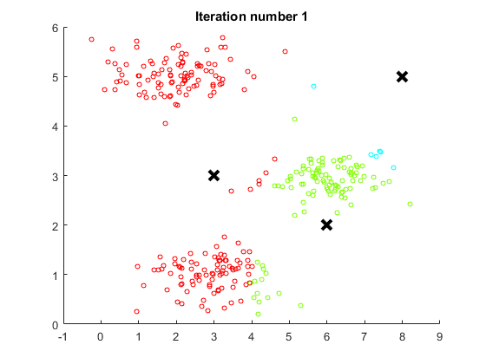
2
K-means clustering algorithm
K-means algorithm
Execution of algorithm

Slide 11
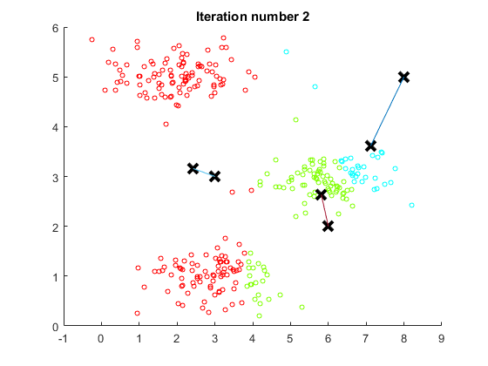
2
K-means clustering algorithm
K-means algorithm
Execution of algorithm

Slide 12
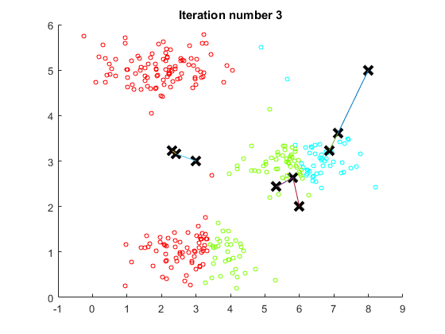
2
K-means clustering algorithm
K-means algorithm
Execution of algorithm

Slide 13
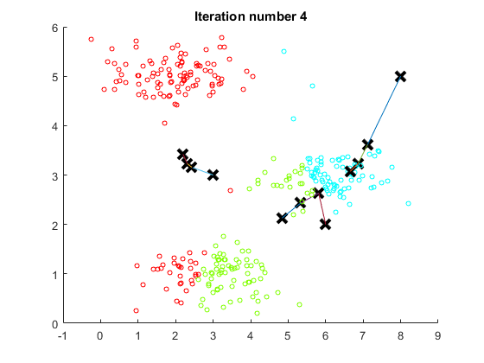
2
K-means clustering algorithm
K-means algorithm
Execution of algorithm

Slide 14
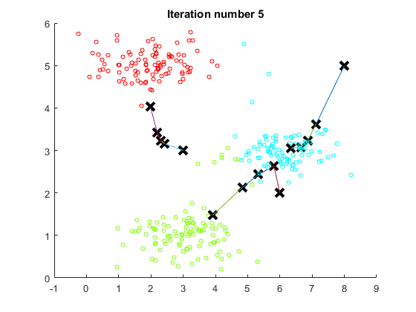
2
K-means clustering algorithm
K-means algorithm
Execution of algorithm

Slide 15
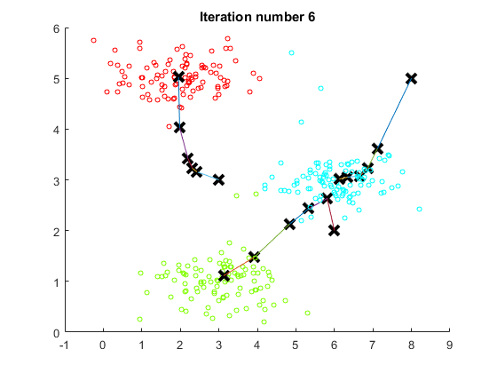
2
K-means clustering algorithm
K-means algorithm
Execution of algorithm

Slide 16

2
K-means clustering algorithm
K-means algorithm objective function
=index of cluster (1,2,…,K) to which example is currently assigned
=cluster centroid k
$$(μ_{k}∈ℝ^{n})$$
=cluster centroid to which example has been assigned

Slide 17
Strengths of k-means
Strengths:
Simple: easy to understand and to implement
Efficient: Time complexity: O(tkn),
where n is the number of data points,
k is the number of clusters, and
t is the number of iterations.
Since both k and t are small. k-means is considered a linear algorithm.
K-means is the most popular clustering algorithm.
Note that: it terminates at a local optimum if Sum of Squared Errors (SSE) is used. The global optimum is hard to find due to complexity.

Slide 18
Weaknesses of k-means
The algorithm is only applicable if the mean is defined.
For categorical data, k-mode - the centroid is represented by most frequent values.
The user needs to specify k.
The algorithm is sensitive to outliers
Outliers are data points that are very far away from other data points.
Outliers could be errors in the data recording or some special data points with very different values.

Slide 19
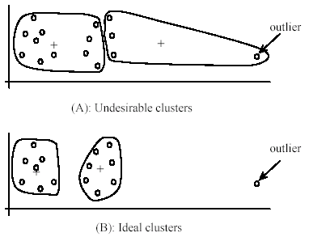
Weaknesses of k-means: Problems with outliers

Slide 20
Weaknesses of k-means: To deal with outliers
One method is to remove some data points in the clustering process that are much further away from the centroids than other data points.
To be safe, we may want to monitor these possible outliers over a few iterations and then decide to remove them.
Another method is to perform random sampling. Since in sampling we only choose a small subset of the data points, the chance of selecting an outlier is very small.
Assign the rest of the data points to the clusters by distance or similarity comparison, or classification

Slide 21
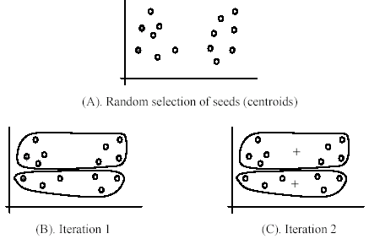
Weaknesses of k-means (cont …)
The algorithm is sensitive to initial seeds.

Slide 22
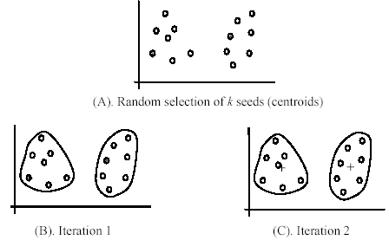
Weaknesses of k-means (cont …)
If we use different seeds: good results
There are some methods to help choose good seeds

Slide 23
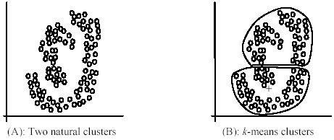
Weaknesses of k-means (cont.)
The k-means algorithm is not suitable for discovering clusters that are hyper-ellipsoids (or hyper-spheres).
+

Slide 24
3
Centroid initialization and choosing the number of K
Random initialization of centroids for K-means algorithm
Number of clusters K<m
Randomly pick K training examples
Set equal to these K examples

Slide 25
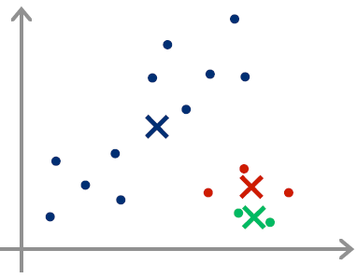
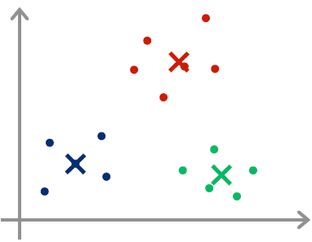
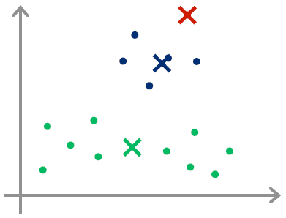
3
Centroid initialization and choosing the number of K
Random initialization of centroids for K-means algorithm
Problem
Ideal case of random initialization
Bad examples of random initialization

Slide 26
3
Centroid initialization and choosing the number of K
Random initialization of centroids for K-means algorithm
Solution
For i =1 to 100 {
Randomly initialize K-means.
Run K-means. Get
Compute cost function:
}
Pick clustering with the lowest cost

Slide 27
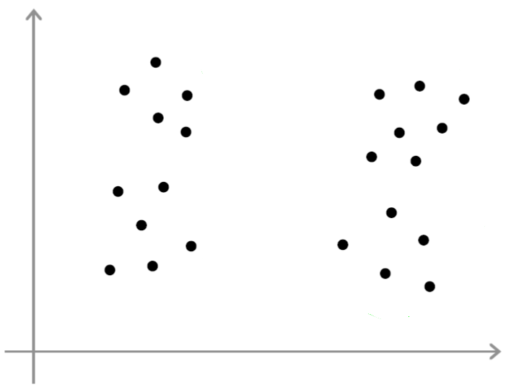
3
Centroid initialization and choosing the number of K
Choosing the number of clusters
What is the right number of clusters? How to choose it?

Slide 28
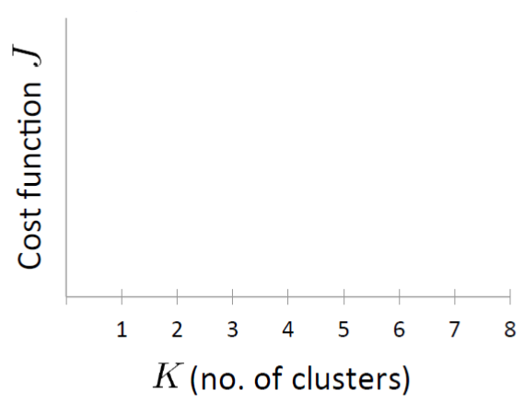
3
Centroid initialization and choosing the number of K
Choosing the number of clusters K
Elbow method

Slide 29

3
Example of K Means Clustering
Dataset:
We have the following 10 data points: (2,10),(2,5),(8,4),(5,8),(7,5),(6,4),(1,2),(4,9),(7,3),(6,8)
Step 1: Initialize k and centroids
Set k=2 (we want 2 clusters).
Randomly initialize 2 centroids: C1=(2,10), C2=(5,8)
Step 2: Assign data points to the nearest centroid
For each data point, calculate the Euclidean distance to each centroid. Assign the point to the cluster with the nearest centroid.
Euclidean Distance Formula:

Slide 30
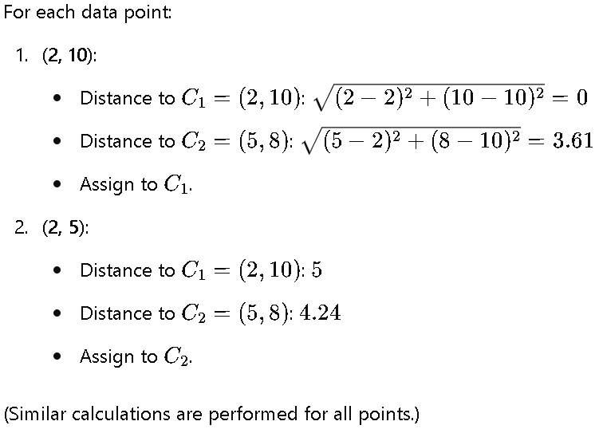
3
Example of K Means Clustering
Dataset:
We have the following 10 data points: (2,10),(2,5),(8,4),(5,8),(7,5),(6,4),(1,2),(4,9),(7,3),(6,8)

Slide 31
3
Example of K Means Clustering
Dataset:
We have the following 10 data points: (2,10),(2,5),(8,4),(5,8),(7,5),(6,4),(1,2),(4,9),(7,3),(6,8)
Step 3: Update centroids
For each cluster, calculate the new centroid by taking the mean of all points assigned to that cluster.
For C1​: Mean of points assigned to C1​. For C2​: Mean of points assigned to C2.
Step 4: Repeat until convergence
Repeat Steps 2 and 3 until the centroids no longer change significantly.

Slide 32
3
Example of K Means Clustering: Python Code
https://colab.research.google.com/drive/1R5TEaFlMV8dRVLH33qcUi8DvuVCyGFUZ?usp=sharing

Slide 33
3
Dimensionality Reduction

Slide 34
Motivation
Dimensionality reduction is the process of reducing the number of input variables, or features, in a dataset while retaining as much meaningful information as possible. It's a crucial technique in machine learning and data analysis.
Why do we need it?
The "Curse of Dimensionality": As the number of features increases, the amount of data needed to support a robust model grows exponentially. High-dimensional data is sparse, making it difficult for algorithms to find patterns.
Efficiency: Fewer features mean less computation time and memory, making models faster to train.
Simpler Models: Models with fewer features are easier to interpret and less prone to overfitting.

Slide 35



4
Dimensionality Reduction
Motivation. Data Compression and Visualization.
Reduce data from 2D to 1D
Mapping
$$x^{(1)}∈ℝ^{2}→z^{(1)}∈ℝ$$
$$x^{(2)}∈ℝ^{2}→z^{(2)}∈ℝ$$
$$x^{(m)}∈ℝ^{2}→z^{(m)}∈ℝ$$

Slide 36

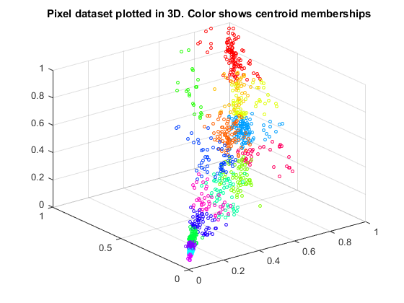
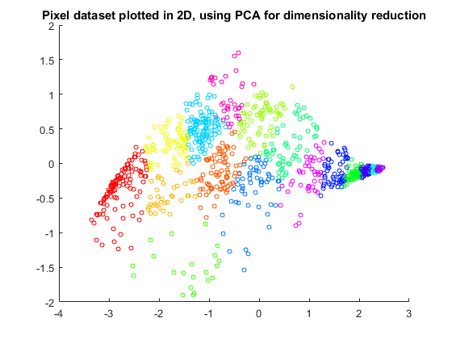


4
Dimensionality Reduction
Embedded
System
Laboratory
Motivation. Data Compression and Visualization.
Reduce data from 3D to 2D
$$x^{(i)}∈ℝ^{3}$$
$$z^{(i)}∈ℝ^{2}$$

Slide 37
Dimensionality reduction
There are two main categories of dimensionality reduction techniques: Feature Selection and Feature Extraction.
Feature selection methods choose a subset of the original features and discard the rest. You are essentially "selecting" the best features to keep.
Feature extraction methods create a new, smaller set of features that are combinations of the original ones. These new features are called "components" or "latent variables."

Slide 38
Dimensionality reduction: Feature Selection
Filter Methods
These methods are applied as a preprocessing step. They score each feature based on a statistical measure and then keep the features with the highest scores. They are fast and independent of the machine learning model you choose later.
Examples:
Chi-Squared Test: Used for categorical features to see how well they predict a categorical target.
Correlation Coefficient: You can calculate the correlation between each feature and the target variable and discard features with low correlation. You can also remove features that are highly correlated with each other (to avoid multicollinearity).

Slide 39
Dimensionality reduction: Feature Selection
Wrapper Methods
These methods use a specific machine learning model to evaluate the usefulness of a subset of features. They "wrap" the feature selection process around the model, treating it like a black box to score different feature combinations. They are more accurate than filter methods but much slower.
Examples:
Forward Selection: Start with no features. Add features one by one, keeping the one that improves the model the most at each step, until adding new features no longer improves performance.
Backward Elimination: Start with all features. Remove features one by one, deleting the one that impacts performance the least at each step, until removing features starts to significantly hurt performance.

Slide 40
Dimensionality reduction: Feature Selection
Embedded Methods
These methods perform feature selection as part of the model training process itself. They are a good compromise between the accuracy of wrapper methods and the speed of filter methods.
Examples:
LASSO (L1) Regularization: This is a powerful technique used in linear models. It adds a penalty to the model's cost function that is proportional to the absolute value of the feature coefficients. This has the effect of shrinking the coefficients of less important features down to exactly zero, effectively removing them from the model.
Ridge (L2) Regularization: Similar to LASSO, but it shrinks coefficients close to zero without setting them exactly to zero. It's less of a feature selection method and more of a way to reduce model complexity.

Slide 41
Dimensionality reduction: Feature Extraction
Principal Component Analysis (PCA)
PCA is the most popular dimensionality reduction technique. It's an unsupervised method that transforms the original features into a new set of uncorrelated features called principal components. These components are ordered so that the first few retain most of the variance (i.e., information) present in the original dataset.
Key Idea: It finds the directions of maximum variance in the data and projects the data onto a new, lower-dimensional subspace without losing much information.
Pros: Very effective at reducing dimensions and handling multicollinearity.
Cons: The new principal components are linear combinations of the original features, making them difficult to interpret. You lose the original meaning of your features.

Slide 42
Dimensionality reduction: Feature Extraction
Linear Discriminant Analysis (LDA)
LDA is a supervised technique, meaning it considers the target variable (class labels). While PCA tries to find the axes with maximum variance, LDA tries to find the axes that maximize the separation between multiple classes.
Key Idea: It projects data onto a lower-dimensional space in a way that makes different classes as distinct as possible.
When to Use: It's an excellent choice for classification problems when you want to reduce dimensions in a way that helps your model distinguish between classes more easily.

Slide 43
4
Principal Component
Analysis

Slide 44
Principal Component Analysis
Step 1: Standardize the Data
PCA is affected by scale. Standardizing ensures each feature has mean = 0 and SD = 1.
Step 2: Calculate the Covariance Matrix
Captures the relationship between features (e.g., how X varies with Y, etc.)
Step 3: Calculate Eigenvectors and Eigenvalues
Eigenvectors define the directions (principal components).Eigenvalues indicate the magnitude (importance) of those directions.
Step 4: Select Principal Components
Choose the top eigenvectors (PC1, PC2,…) for projecting data to lower dimension.
Step 5: Transform the Data onto the New Plane
Multiply the original standardized data by the selected eigenvectors.

Slide 45
A 3D to 2D Numerical Example

Slide 46
PCA Example
Let's imagine we have data for four different products with three features: 'Feature X' (e.g., weight), 'Feature Y' (e.g., durability), and 'Feature Z' (e.g., user rating).
Product | Feature X | Feature Y | Feature Z
A | 4 | 1 | 1
B | 5 | 3 | 2
C | 8 | 5 | 4
D | 9 | 7 | 5

Slide 47
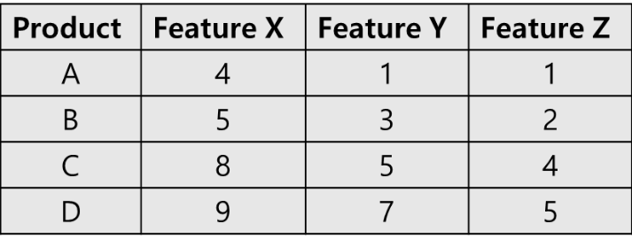
PCA Example
Step 1: Standardize the Data
First, we scale the data so that each feature has a mean of 0 and a standard deviation of 1. This prevents features with larger scales from dominating the analysis.
1a. Calculate the mean of each feature:
Mean of X: (4+5+8+9)/4=6.5
Mean of Y: (1+3+5+7)/4=4.0
Mean of Z: (1+2+4+5)/4=3.0
1b. Calculate the standard deviation of each feature:
Std. Dev. of X: ≈2.38
Std. Dev. of Y: ≈2.58
Std. Dev. of Z: ≈1.83

Slide 48
PCA Example
1c. Apply the standardization formula:
(value−mean)/std_dev
This gives us our new standardized dataset:
Product | Standardized X | Standardized Y | Standardized Z
A | -1.05 | -1.16 | -1.09
B | -0.63 | -0.39 | -0.55
C | 0.63 | 0.39 | 0.55
D | 1.05 | 1.16 | 1.09

Slide 49
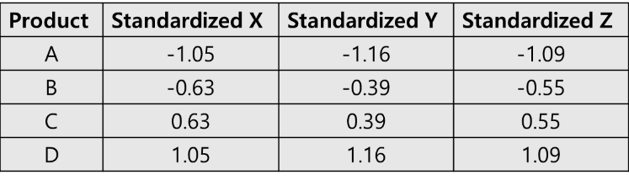
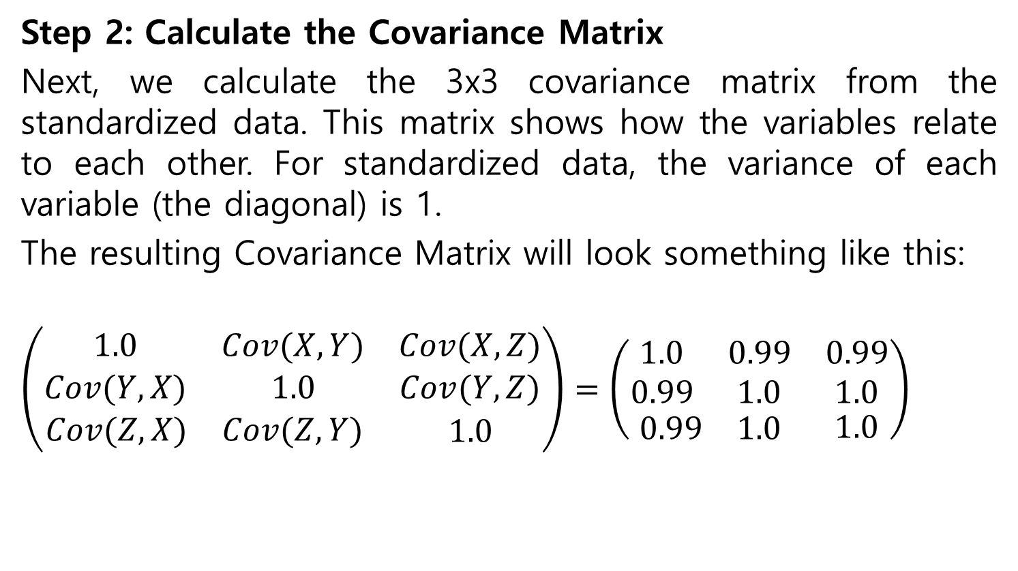
PCA Example
Step 2: Calculate the Covariance Matrix
Next, we calculate the 3x3 covariance matrix from the standardized data. This matrix shows how the variables relate to each other. For standardized data, the variance of each variable (the diagonal) is 1.
The resulting Covariance Matrix will look something like this:
$$\left(\begin{matrix}\begin{matrix}1.0 & Cov(X,Y) \\ Cov(Y,X) & 1.0\end{matrix} & \begin{matrix}Cov(X,Z) \\ Cov(Y,Z)\end{matrix} \\ \begin{matrix}Cov(Z,X) & Cov(Z,Y)\end{matrix} & 1.0\end{matrix}\right)=\left(\begin{matrix}\begin{matrix}1.0 & 0.99 \\ 0.99 & 1.0\end{matrix} & \begin{matrix}0.99 \\ 1.0\end{matrix} \\ \begin{matrix}0.99 & 1.0\end{matrix} & 1.0\end{matrix}\right)$$
Note: The high covariance values indicate our features are strongly correlated, making this a good candidate for PCA.

Slide 50
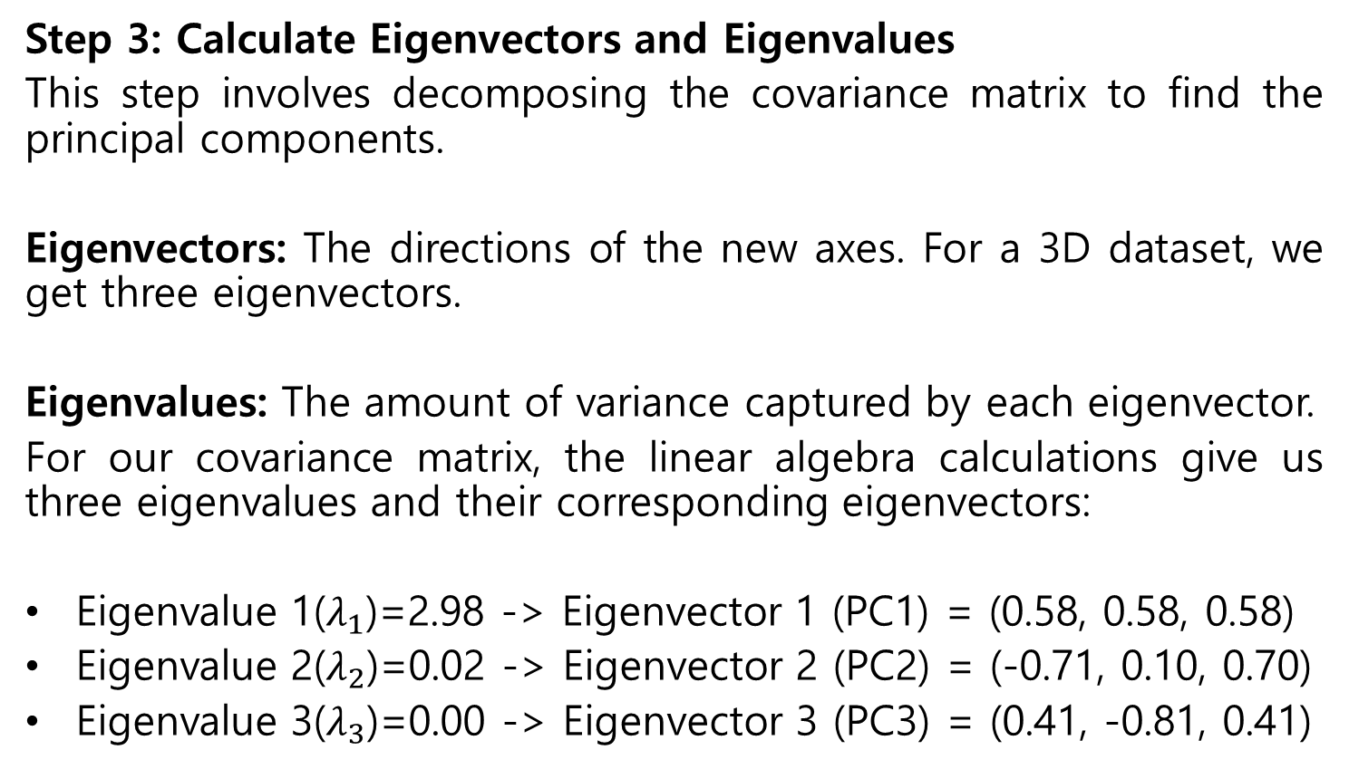
PCA Example
Step 3: Calculate Eigenvectors and Eigenvalues
This step involves decomposing the covariance matrix to find the principal components.
Eigenvectors: The directions of the new axes. For a 3D dataset, we get three eigenvectors.
Eigenvalues: The amount of variance captured by each eigenvector.
For our covariance matrix, the linear algebra calculations give us three eigenvalues and their corresponding eigenvectors:
Eigenvalue 1($λ_{1}$)=2.98 -> Eigenvector 1 (PC1) = (0.58, 0.58, 0.58)
Eigenvalue 2($λ_{2}$)=0.02 -> Eigenvector 2 (PC2) = (-0.71, 0.10, 0.70)
Eigenvalue 3($λ_{3}$)=0.00 -> Eigenvector 3 (PC3) = (0.41, -0.81, 0.41)

Slide 51
PCA Example
Step 4: Select Principal Components
We rank the eigenvectors by their eigenvalues from highest to lowest. The vectors with the highest eigenvalues capture the most information.
PC1 (Eigenvalue = 2.98)
PC2 (Eigenvalue = 0.02)
PC3 (Eigenvalue = 0.00)
Since our goal is to reduce the data from 3D to 2D, we will select the top two principal components: PC1 and PC2.
Let's check how much variance these two components retain:
Total Variance = 2.98+0.02+0.00=3.0
Explained by PC1 + PC2 = (2.98+0.02)/3.0=3.0/3.0=100%
In this case, our top two components capture virtually all the information from the original dataset.

Slide 52
PCA Example
Step 5: Transform the Data onto the New 2D Plane
Finally, we project the standardized 3D data onto our two chosen principal components (PC1 and PC2) to get the new 2D coordinates.
We do this by taking the dot product of each standardized data point with each of our chosen eigenvectors.
For Product A:
New X-coordinate (on PC1):
(−1.05∗0.58)+(−1.16∗0.58)+(−1.09∗0.58)=−0.61−0.67−0.63=−1.91
New Y-coordinate (on PC2):
(−1.05∗−0.71)+(−1.16∗0.10)+(−1.09∗0.70)=0.75−0.12−0.76=−0.13
Repeating this for all data points gives us our final 2D dataset.

Slide 53
PCA Example
Result
The original 3D data has been successfully transformed into a 2D representation.
Product | Original (X, Y, Z) | New 2D Coordinates (PC1, PC2)
A | (4, 1, 1) | (-1.91, -0.13)
B | (5, 3, 2) | (-0.91, 0.04)
C | (8, 5, 4) | (0.91, -0.04)
D | (9, 7, 5) | (1.91, 0.13)
These new coordinates can now be easily plotted on a 2D scatter plot to visualize the relationships between the products.

Slide 54
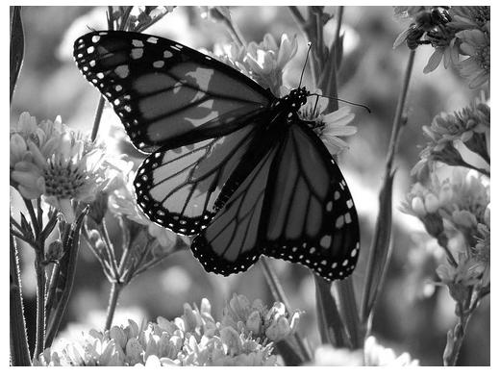
Original Image
Application: Image compression
Divide the original 372x492 image into patches:
Each patch is an instance that contains 12x12 pixels on a grid
View each as a 144-D vector

Slide 55

PCA compression: 144D → 60D

Slide 56
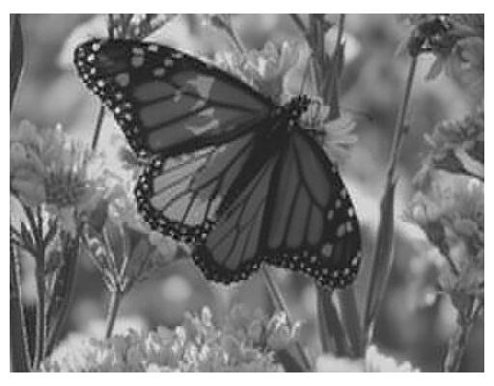
PCA compression: 144D → 16D

Slide 57

PCA compression: 144D ) 6D

Slide 58
6 most important eigenvectors

Slide 59

PCA compression: 144D → 3D

Slide 60
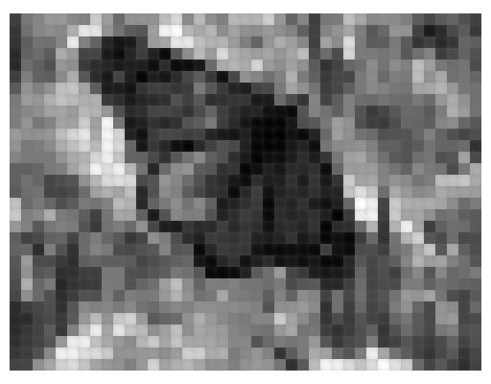
PCA compression: 144D → 1D

